Slide 1

राजस्थान स्टेट ओपन स्कूल, जयपुर

Slide 2
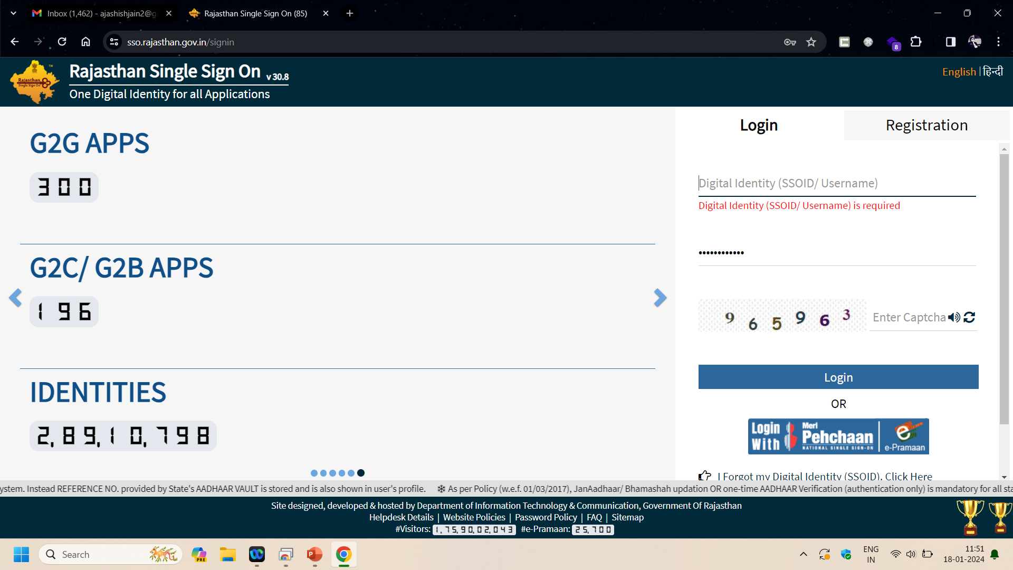
Visit sso.rajasthan.gov.in

Slide 3
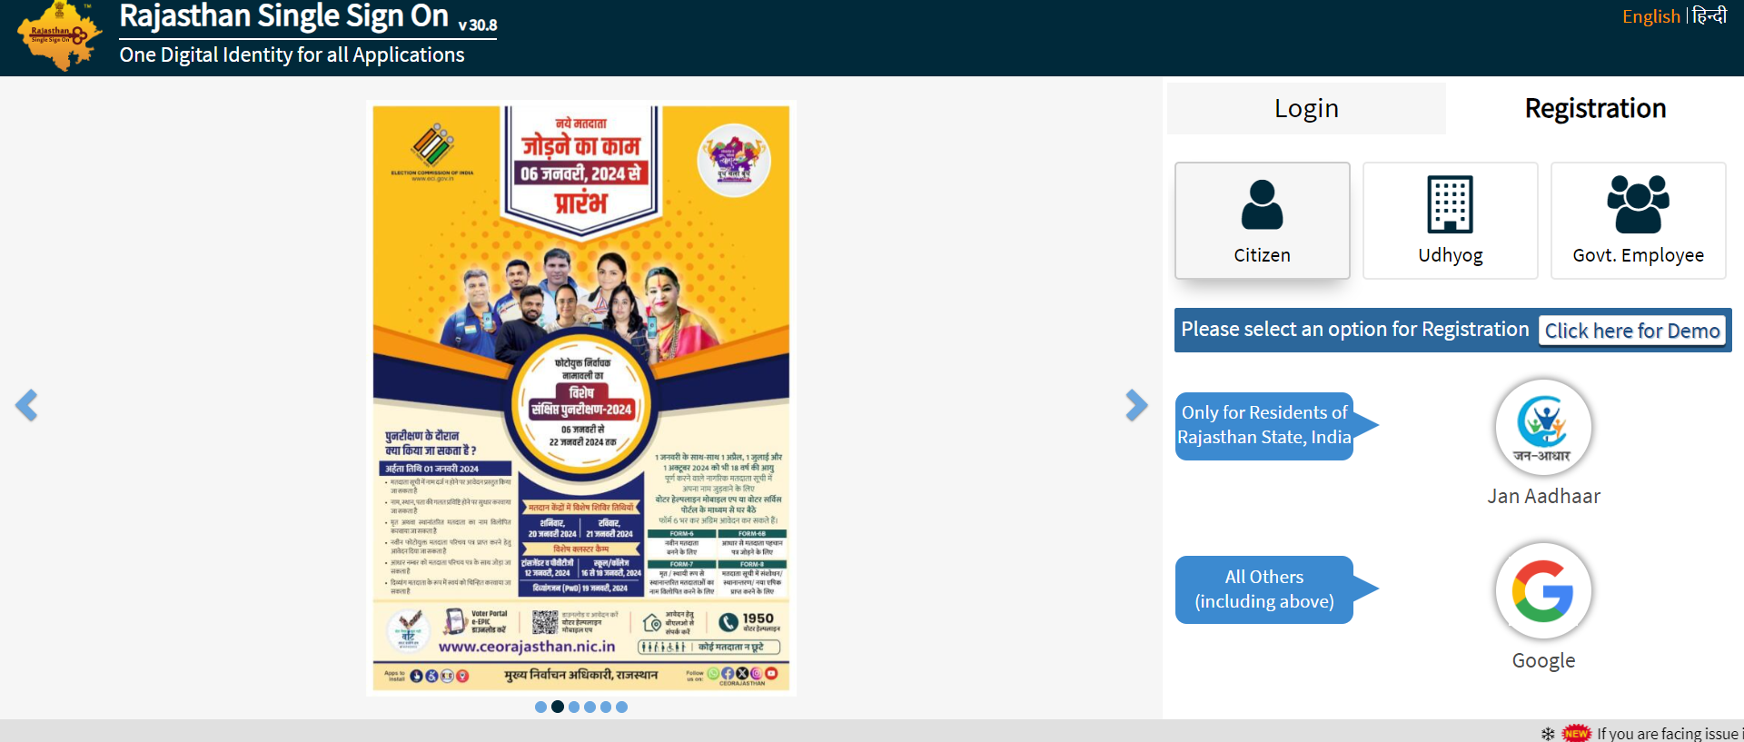
Register on sso.rajasthan.gov.in

Slide 4
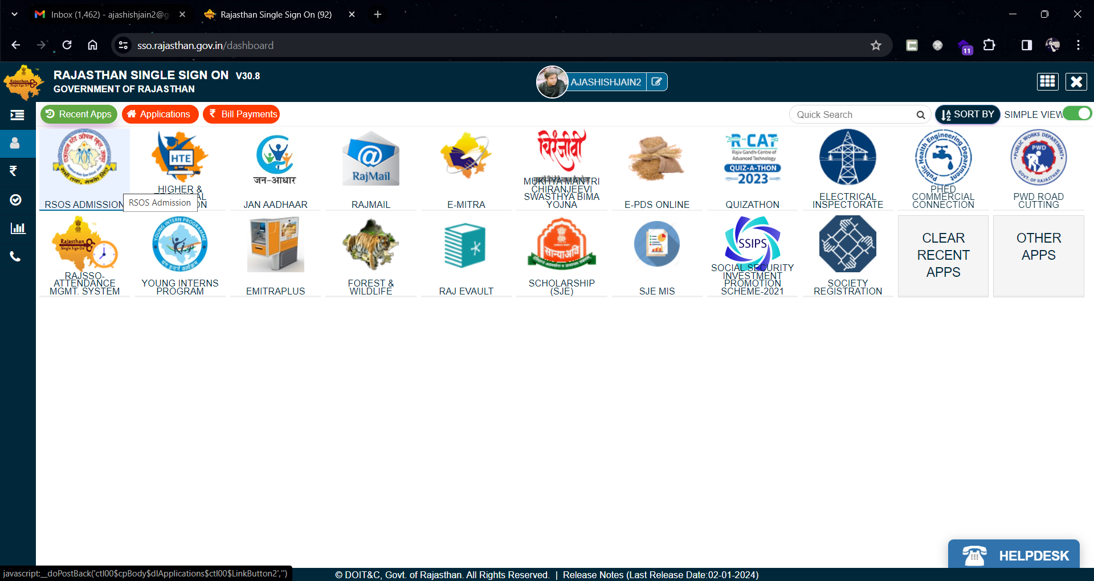
Once registered on sso.rajasthan.gov.in login on SSO portal and click on RSOS Admission application

Slide 5
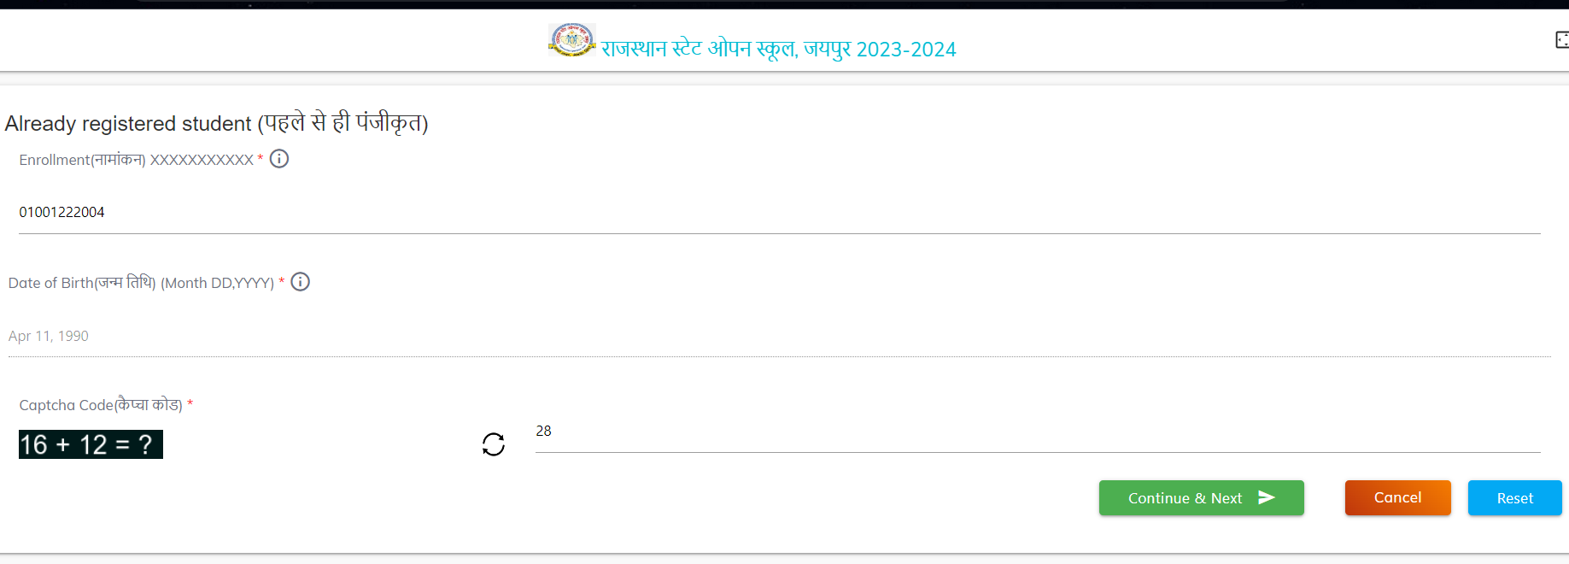
On clicking on RSOS Admission application you will be directed to the form for mapping SSOID where the user enter the Enrolment and DOB

Slide 6
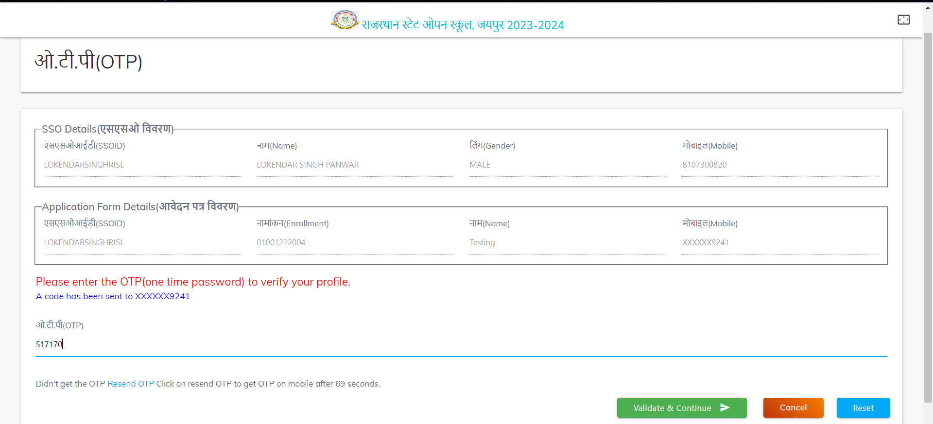
User will be able to see student information filled in the admission form and SSO Portal and for mobile number verification a OTP will be sent to the user on the registered mobile number in form

Slide 7
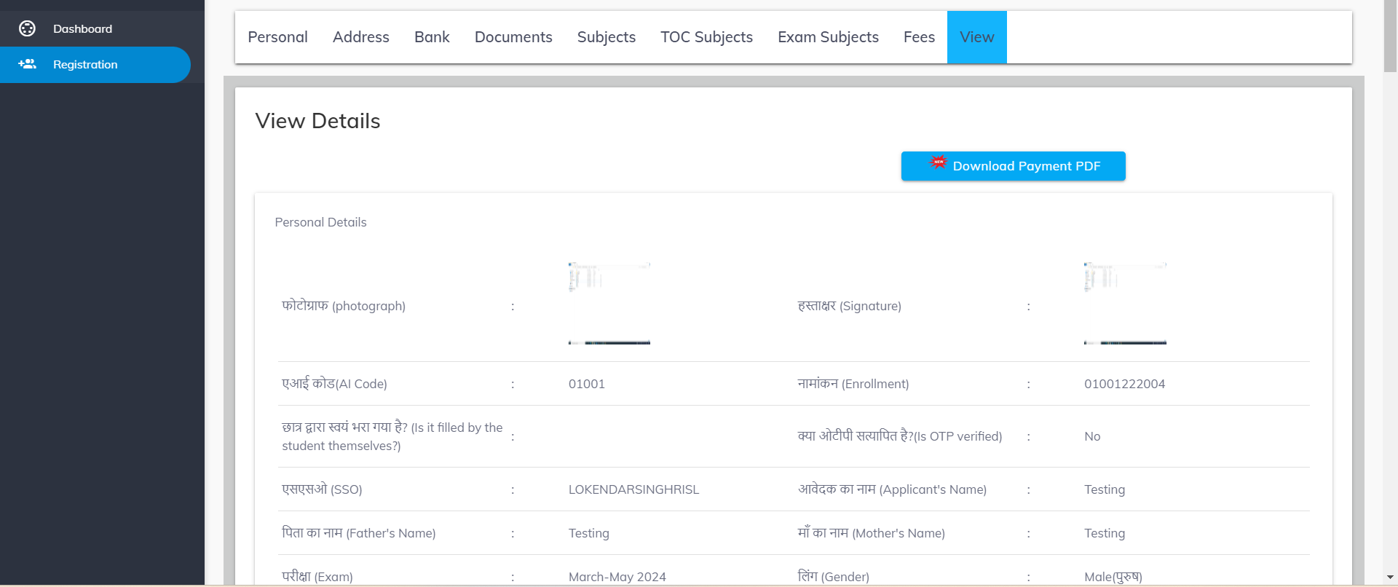
Once validated the user will be able to see the filled application form

